Slide 1
Nimbus Store
L'Oréal Likourgos
IS640: Cloud Computing and virtualization
Dr. Charles lively
“python Dropbox software”

Slide 2
Mission
Nimbus Store allows users to link to a Drobox account to store their files.

Slide 3
Required Steps
Create a Drobox account.
Create a folder inside your “Public” directory.
Create a test file inside that folder.
Create a Google App Engine account.
Register a unique app-id.
App will run at <app-id>.appspot.com
Develop code in Google App Engine Launcher with Python
Deploy it to App Engine.

Slide 4
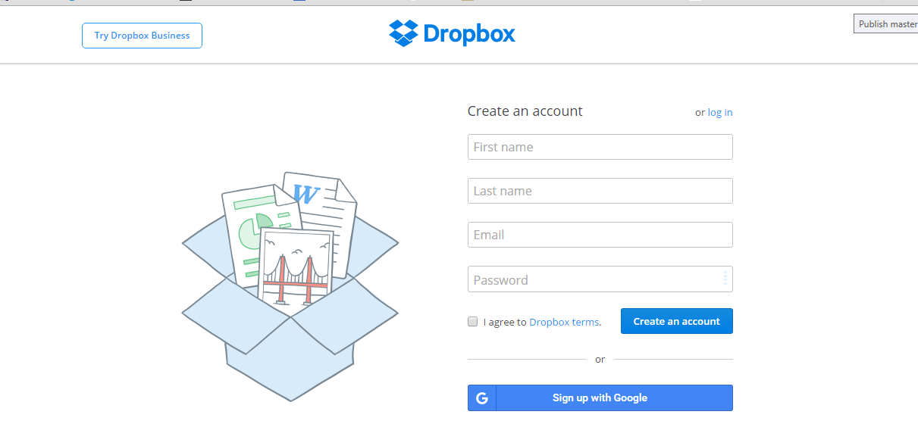
Dropbox Account Setup

Slide 5
“Public” folder in Dropbox
Click on the “new folder” icon
“Public” folder created

Slide 6
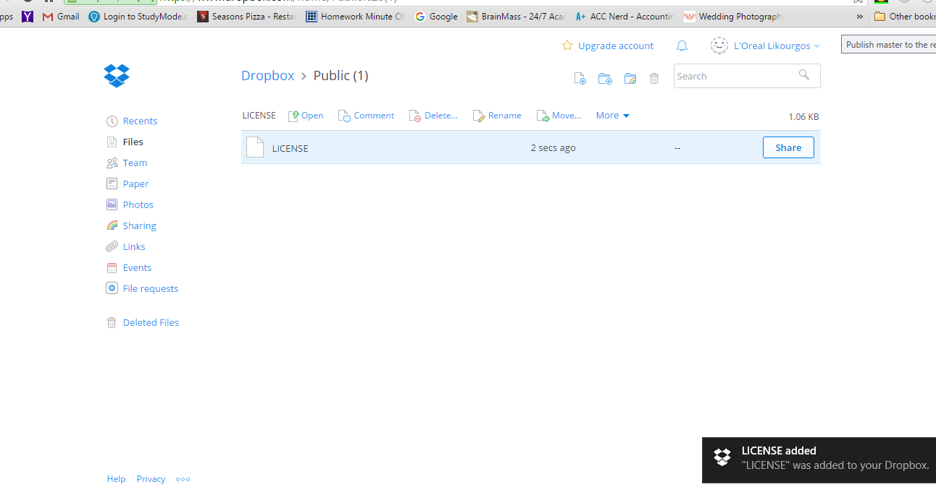
Test File in Public Folder
Click on “Upload Files” icon
Test file example
Confirmation file was added

Slide 7
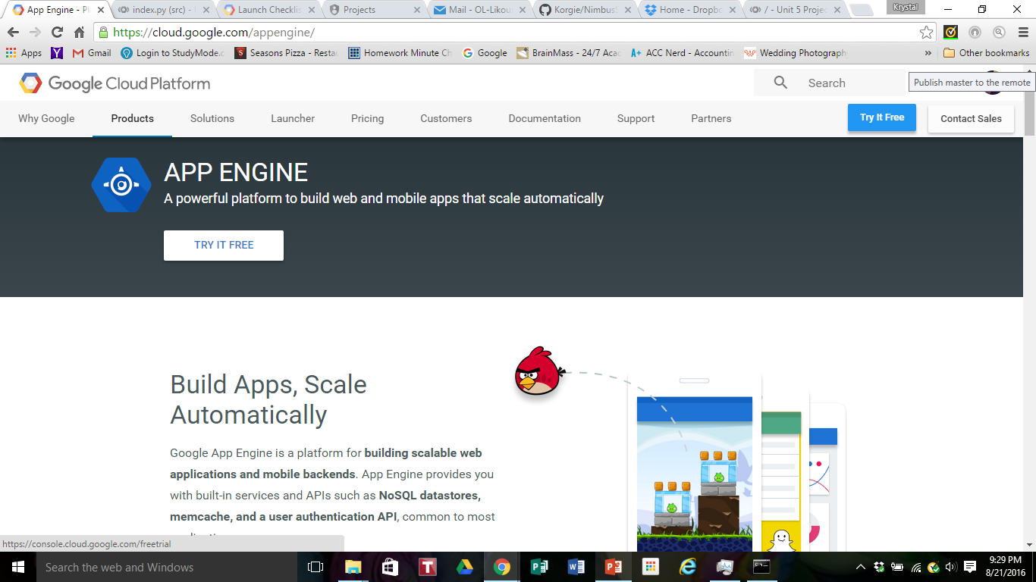
Creating Google App Engine Account
Click on this link to create an account

Slide 8
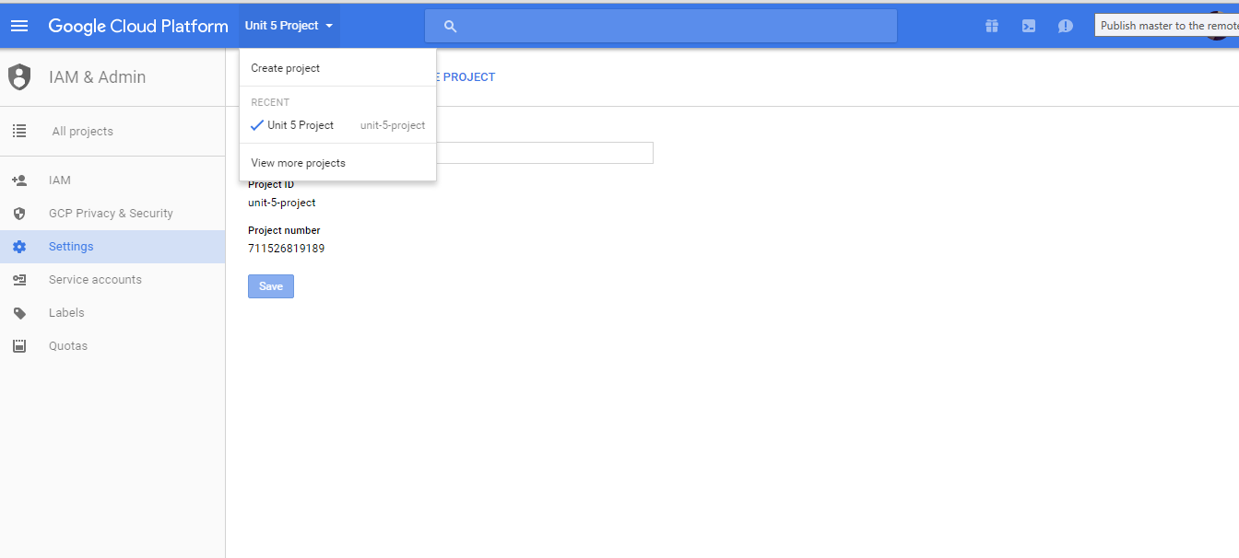
Register Unique App-ID
Create a new project to register a unique app id

Slide 9
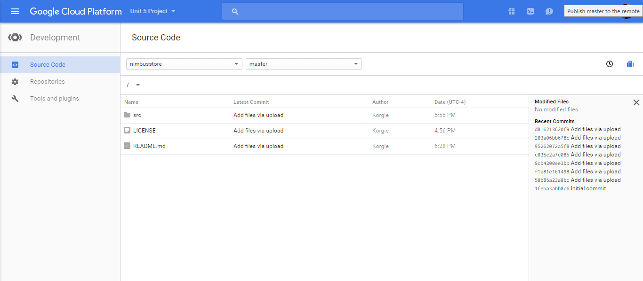
Develop code in Google App Engine Launcher w Python

Slide 10
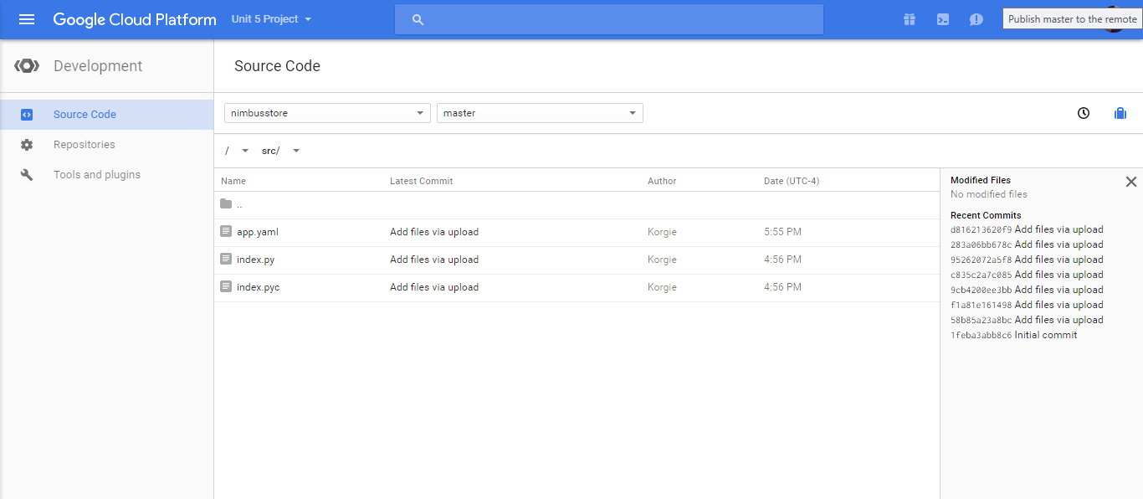
Develop code in Google App Engine Launcher w Python

Slide 11
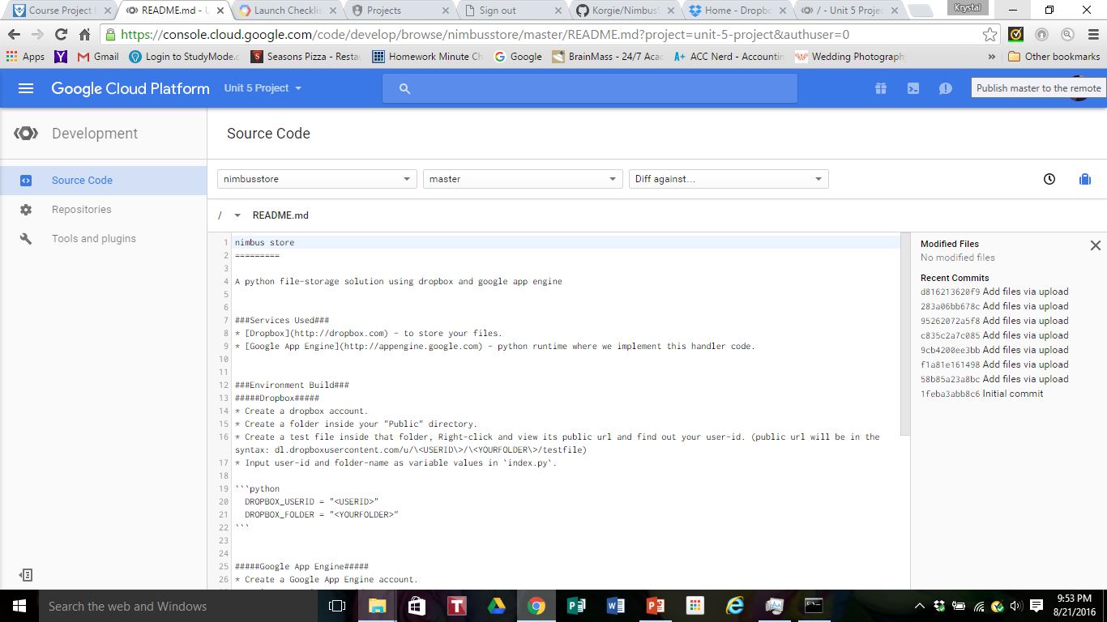
Coded Instructions

Slide 12
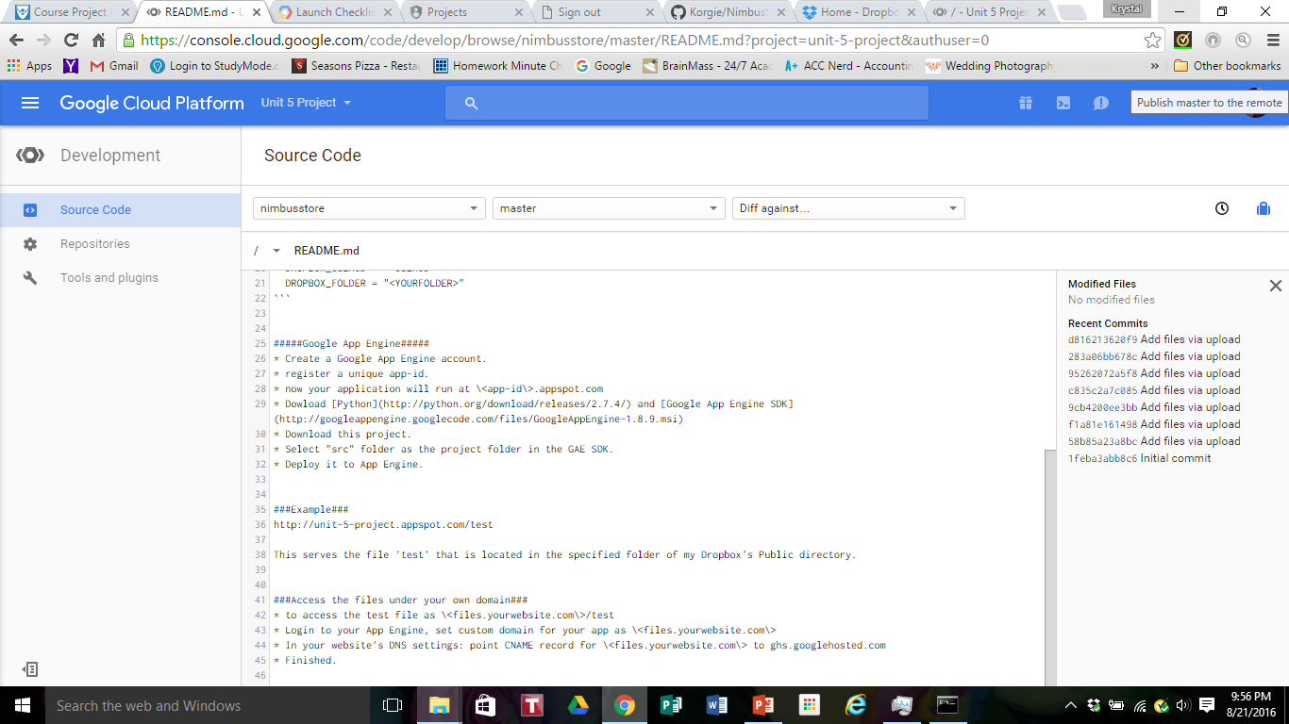
Coded Instructions

Slide 13
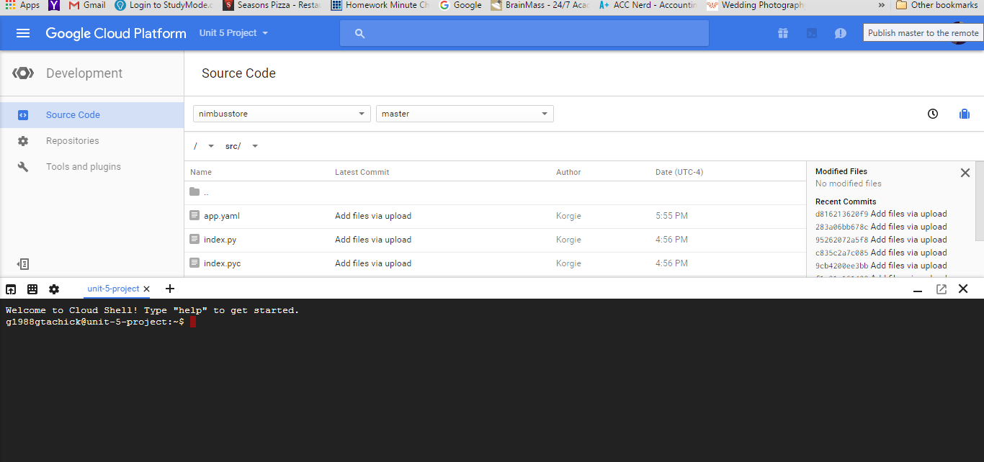
Deploy Code to Cloud Shell/App Engine
A successfully deployed app will load this page with a test file.

Slide 14
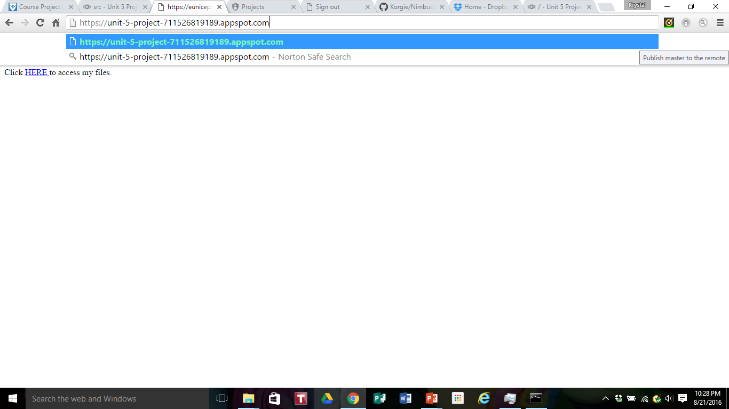
Screen 1 of Deployed Application
Once the app is deployed, you SHOULD be able to access the app via the site and click on the hyperlink to upload files

Slide 15
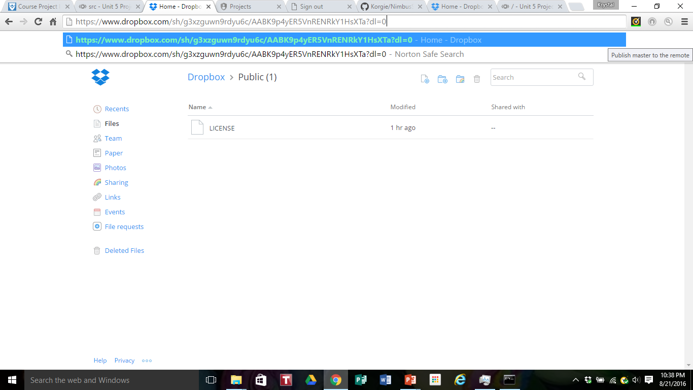
Screen 1 of Deployed Application
If the site launches successfully, the user will be able to upload any files they’d like to store
https://unit-5-project.appspot.com

Slide 16
Reference
Code modified from original source by: Arjun Sreedharan

